Slide 1
Intelligent Ground Vehicle Challenge (IGVC) : GoBot
01/24/17
Anna Cao, Emma Caraher,
Kanghyun Choi (Gabe), Qianru Jia (Sally)

Slide 2
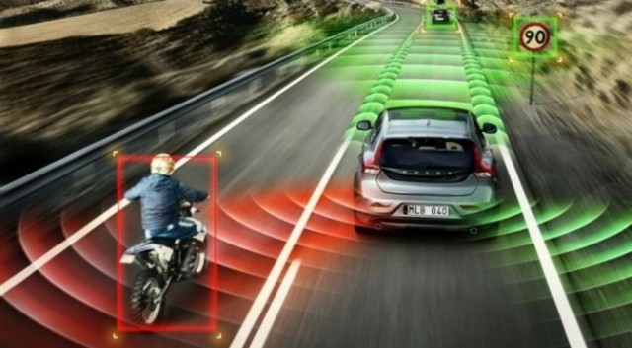
Problem Definition
Future moving towards autonomous cars
Avoid unexpected obstacles
Weather
Traffic
Accidents
Animals
Etc
Safe use, quick reactions, and intelligent decisions are needed!

Slide 3
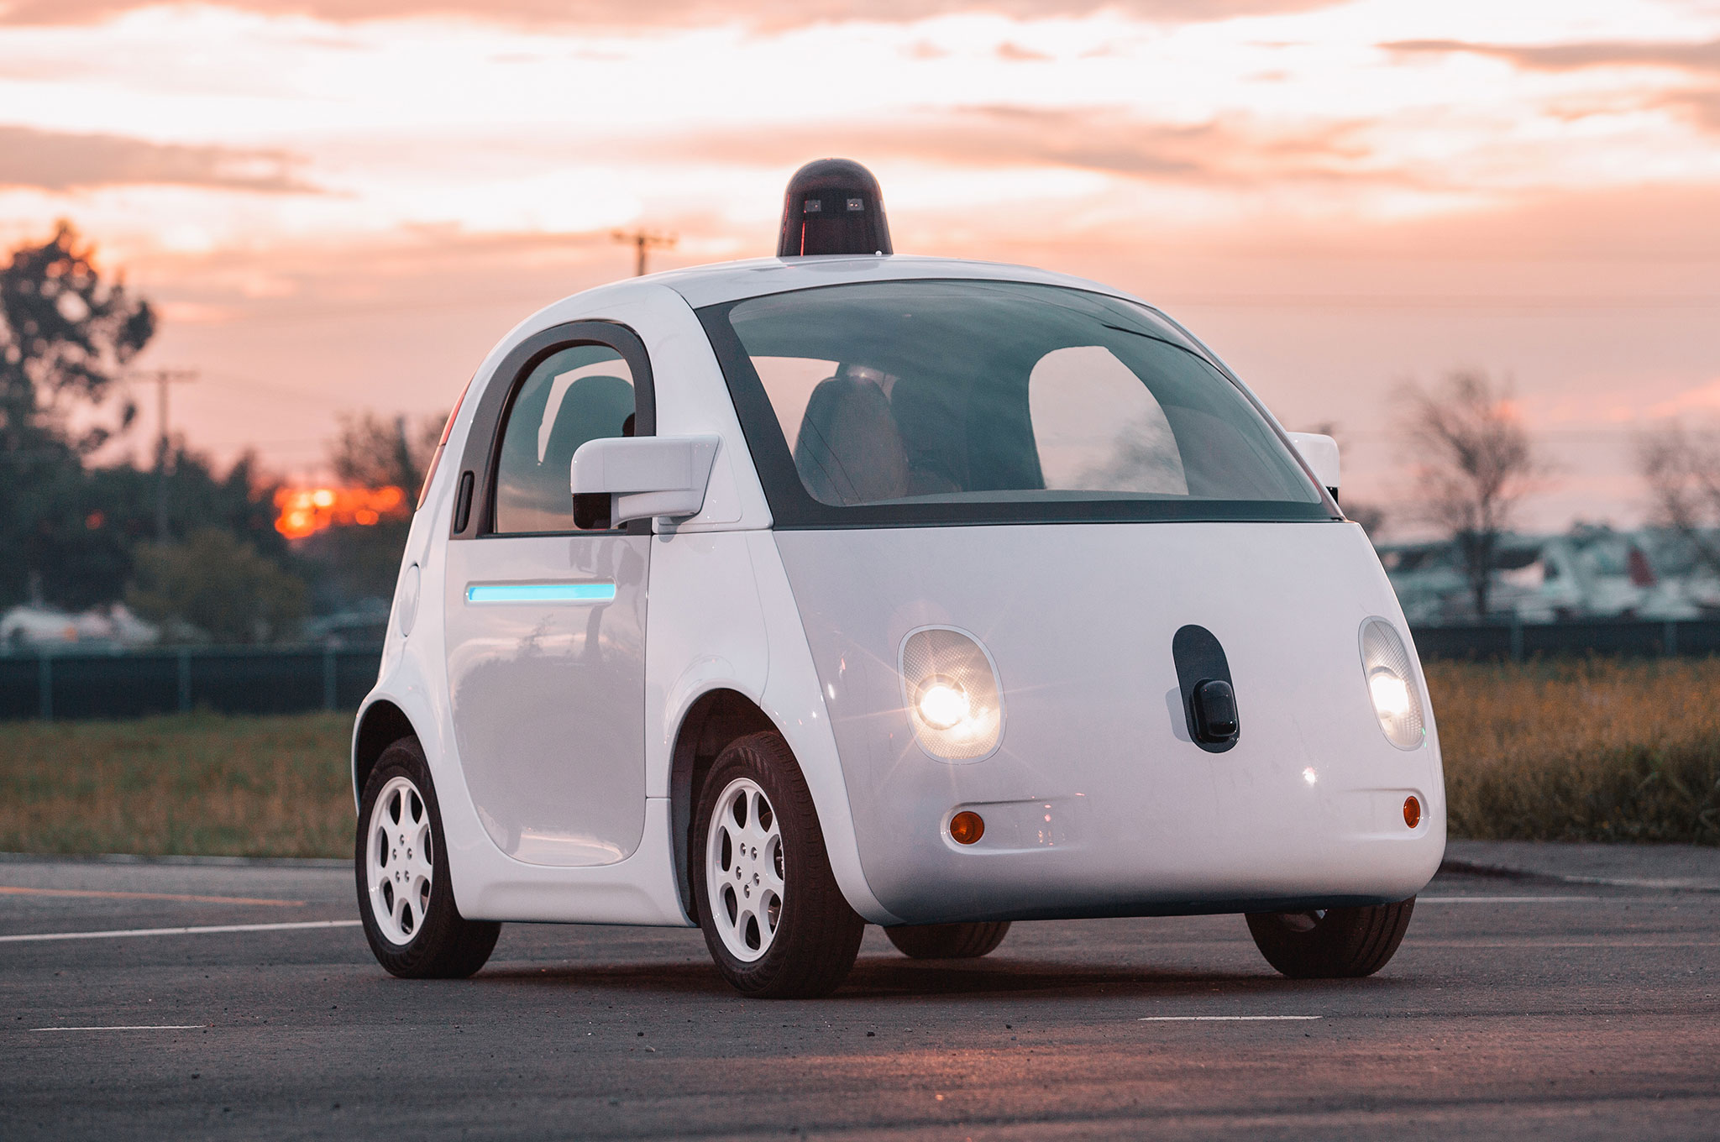
Customers
Tesla
Google
Mercedes-Benz
General Motors
Nissan
Toyota
Volvo
And many more!

Slide 4
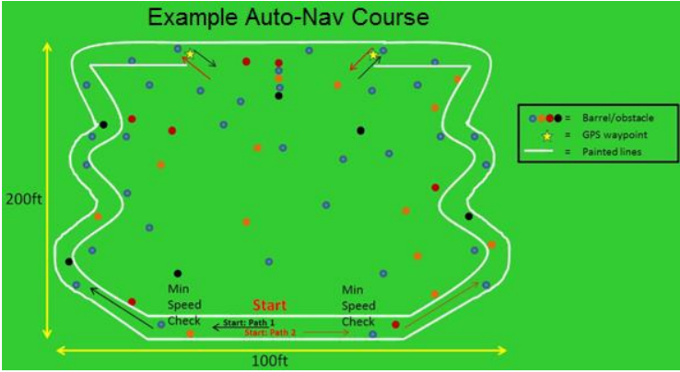
Competition Rules
Speed requirements: between 1 mph and 5 mph
Lane following
Obstacle avoidance
Ramps (smaller than 15 degrees)
Random objects
Potholes
Waypoint navigation
Unmanned and autonomousous

Slide 5
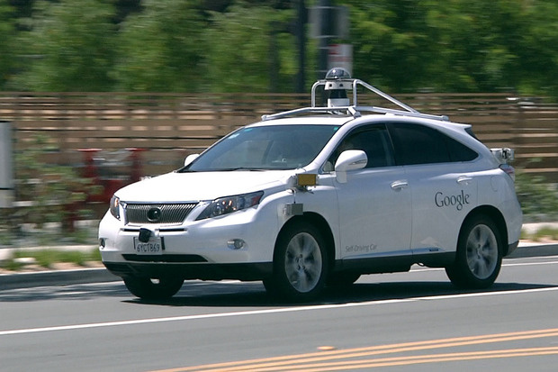
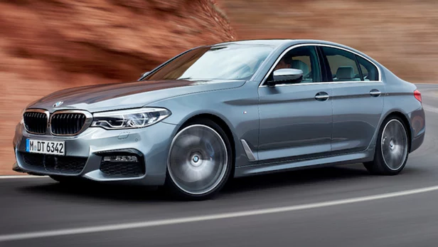
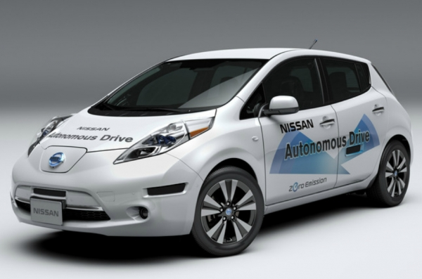
Benchmarks
 | Google - WAYMO | BMW - 5 Series | Nissan - Leaf
Featured Technology | LIDAR on the roof Camera Front and side radar Wheel encoder Inertial measuring unit | Video camera Radar sensors Side laser scanners Ultrasonic sensors GPS | Front and side radar Four wide-angle cameras Front, rear, and side laser scanner
Notes:
*competition teams
Cost, advantage & disadv

Slide 6
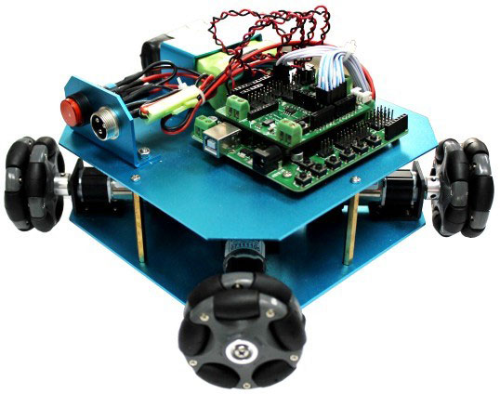
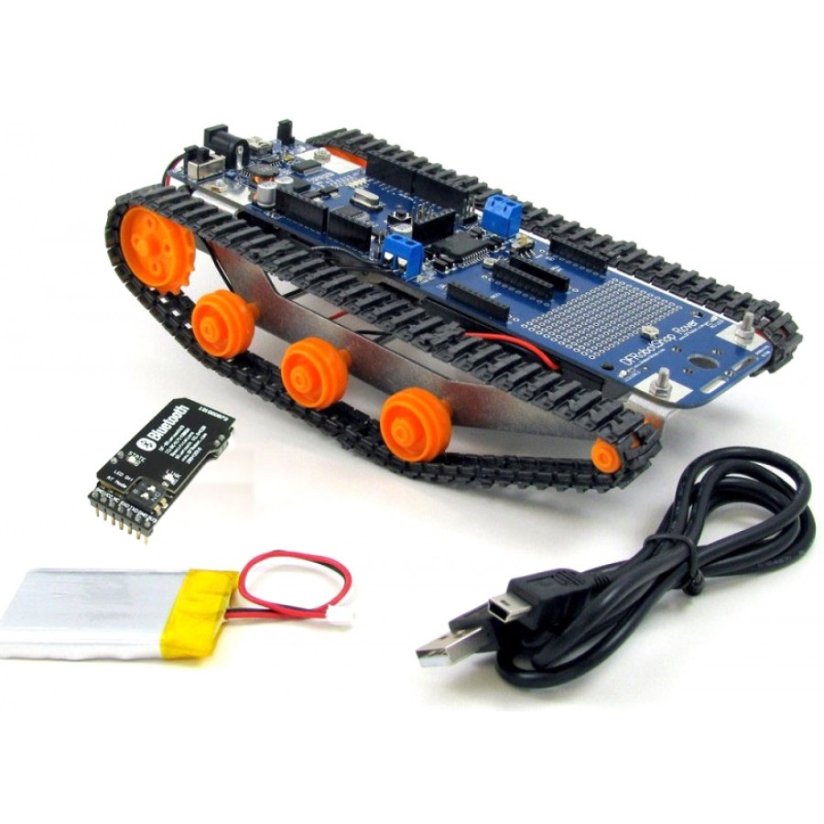
Proposed Solution
Robotic Platform | Omni-wheel Robot | Tracked Robot
Advantage | Can move smoothly in all directions Simple design and construction | More contact area to ground to prevent slipping Evenly distributed weight
Disadvantage | Small contact area May slip | High mechanical complexity Drive sprocket limits the number of motors Might not handle terrain well

Slide 7
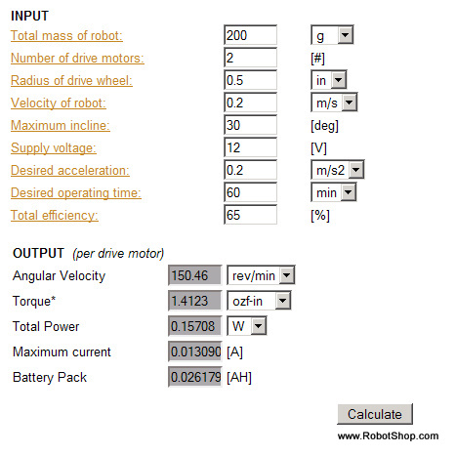
Proposed Solution
DC drive motor select tool

Slide 8
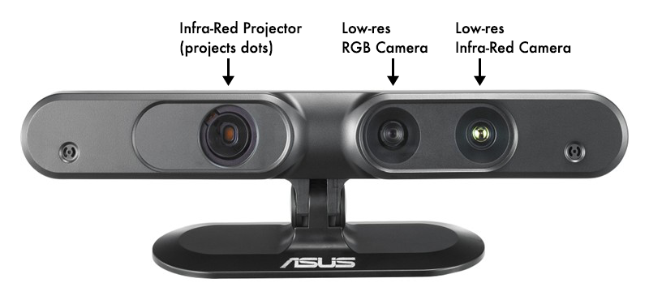
Proposed Solution
Depth camera
Advantages: high precision, easy to operate
Disadvantage: Expensive
Project a pattern of IR light as dots
Capture the IR dots then the processor works out the depth from the displacement of dots

Slide 9
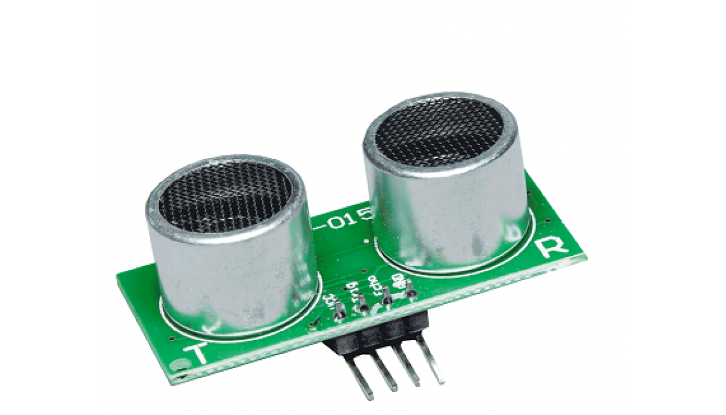
Proposed Solution
Ultrasonic Sensor
Can detect objects and provide an analog value of distance of the object for use in projects and control system
Advantages: low cost <$20
Disadvantage: small inductive angle < 15 degree, low precision

Slide 10
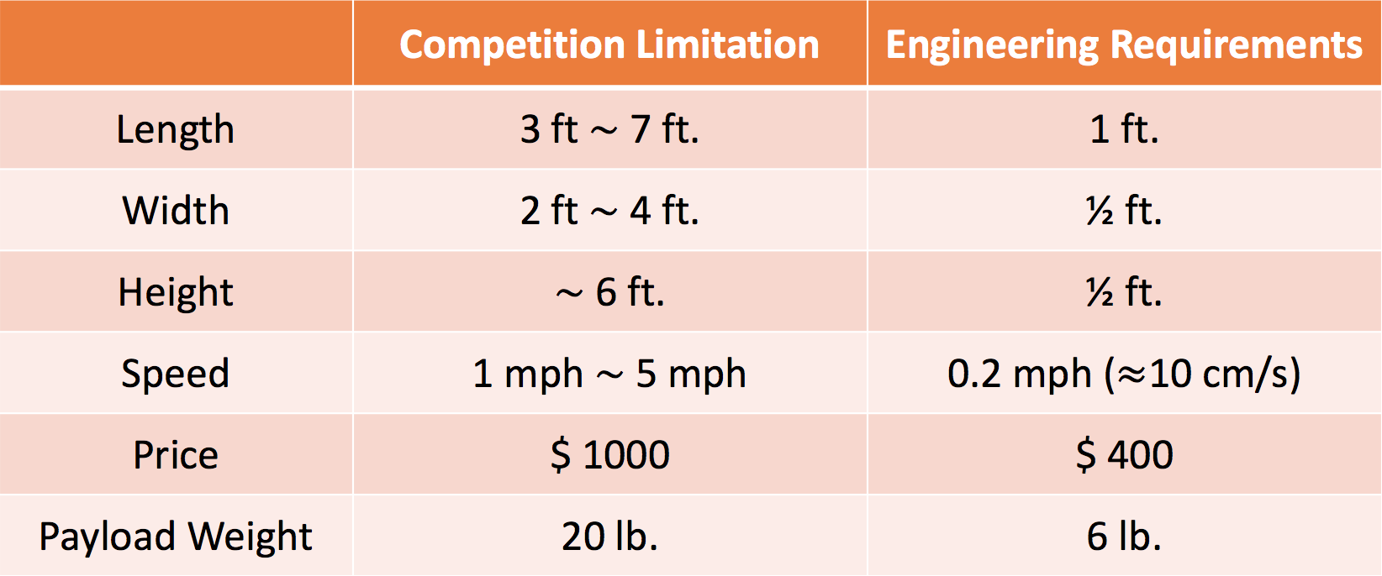
Engineering Requirements
6 lb

Slide 11
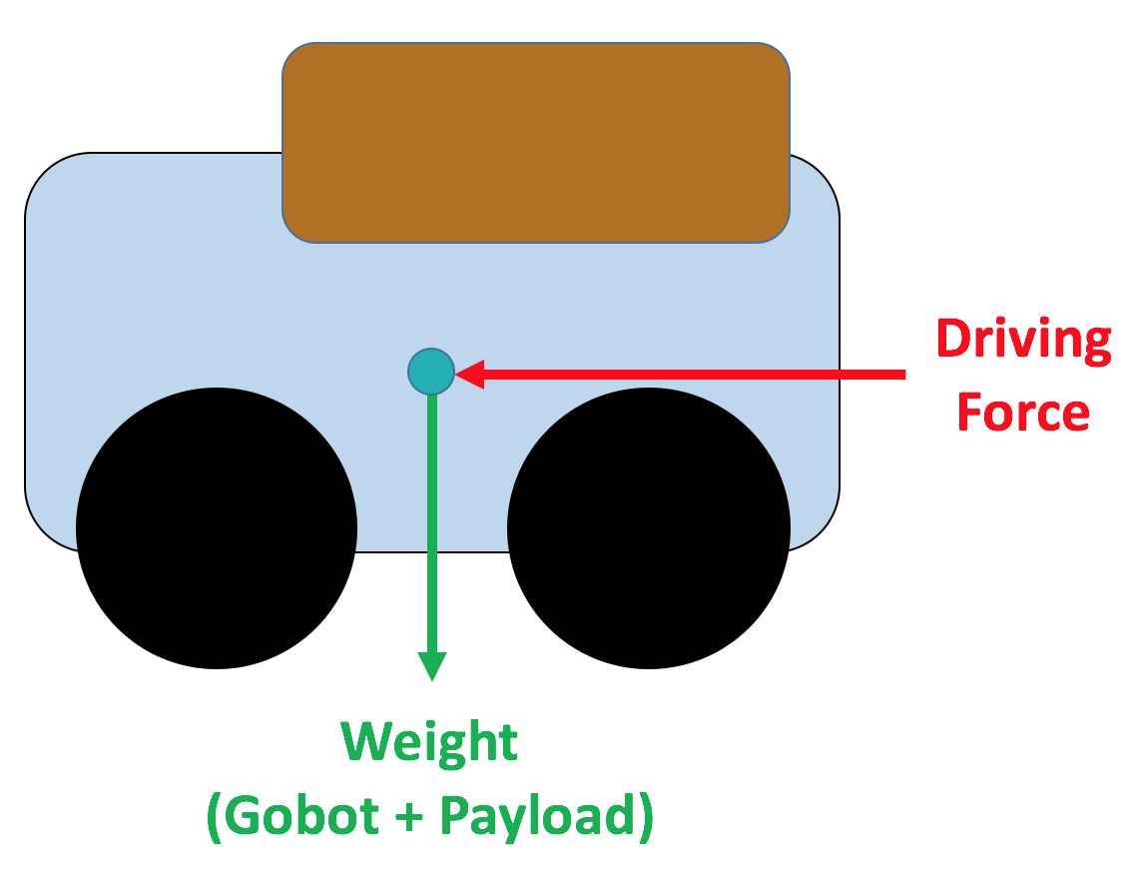
Physics of the Problem
Expected Motor Specs
Required Torque : 2.835 Nm
Power : 3.72 W
Notes:
Basic FBD, assumption for payload

Slide 12
Safety Check
Remote control vehicle (can be avoided by safety light and e-stops)
Vibration shock
Potential voltage danger (12-24V)
Machine design

Slide 13
Team Organization
Mechanical Design (frame, CAD) - Anna, Gabe
Electronics Design (sensor, actuator) - Gabe, Sally
Software Strategy (coding) - Emma
Safety - Everyone
Prototype - Everyone

Slide 14
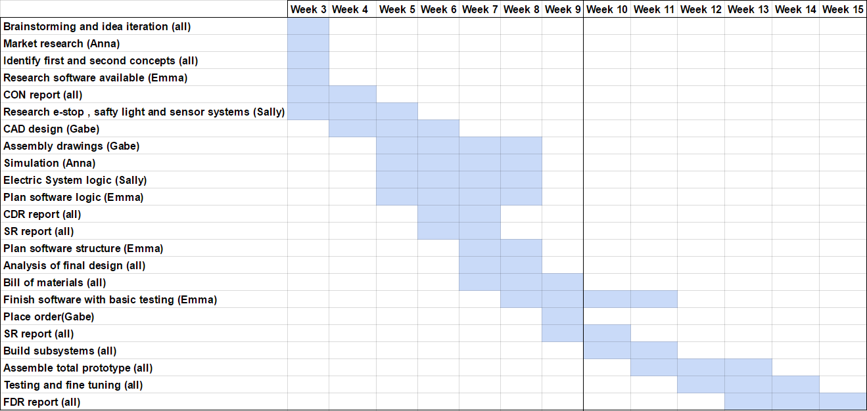
Future Plan

Slide 15
Reference
[1] Drive Motor Sizing Tool. Retrieved January 22, 2017, from http://www.robotshop.com/blog/en/drive-motor-sizing-tool-9698
[2] McWilliams, A. (1970, August 11). Andrew McWilliams. Retrieved January 22, 2017, from https://jahya.net/blog/how-depth-sensor-works-in-5-minutes/
[3] High Accuracy Ultrasonic Sensor. (n.d.). Retrieved January 22, 2017, from http://www.progressiveautomations.com/lc-217?gclid=CjwKEAiAqozEBRDJrPem0fPKtX0SJAD5sAyH_V5-pgZMDnbGI4odyl5Y4trEv1qqyN8ia13WKetbCRoCr67w_wcB

Slide 16
Question?

